Slide 1

IT5002
Computer Systems and Applications
Pipelining
colintan@nus.edu.sg

Slide 2
Q & A
DO NOT use the Zoom chat for questions. It doesn’t appear in the video recordings.
Please ask questions at https://sets.netlify.app/module/61597486a7805d9fb1b4accd
OR scan this QR code (may be obscured on some slides)

Slide 3
IT5002 Midterms
IT5002 Midterms:
Saturday 1 October 2.30 pm to 3.30 pm
Tutorial Groups 1 – 5, I3 Auditorium
Tutorial Groups 6 – 8, LT15
Coverage: Lectures 1 to 10

Slide 4
Lecture #14: Pipelining
Introduction
MIPS Pipeline Stages
Pipeline Datapath
Pipeline Control
Pipeline Performance

Slide 5
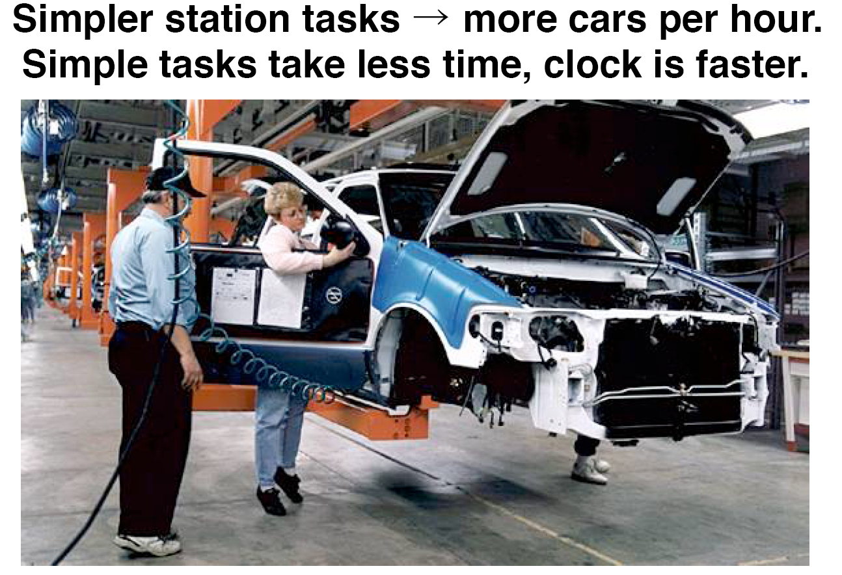
1. Introduction: Inspiration
Assembly Line

Slide 6
1. Introduction: Laundry
Ann, Brian, Cathy, Dave each have one load of clothes to wash, dry, fold and stash
Washer takes 30 minutes
Dryer takes 30 minutes
“Folder” takes 30 minutes
“Stasher” takes 30 minutes to put clothes into drawers
A
B
C
D

Slide 7
1. Introduction: Sequential Laundry
6 PM
7
8
9
10
11
12
1
2 AM
T
a
s
k
O
r
d
e
r
30
30
30
30
30
30
30
30
30
30
30
30
30
30
30
30
Time
A
B
C
D
Sequential laundry takes 8 hours for 4 loads
Steady state: 1 load every 2 hours
If they learned pipelining, how long would laundry take?

Slide 8
1. Introduction: Pipelined Laundry
6 PM
7
8
9
10
11
12
1
2 AM
T
a
s
k
O
r
d
e
r
Time
30
30
30
30
30
30
30
A
B
C
D
Pipelined laundry takes 3.5 hours for 4 loads!
Steady state: 1 load every 30 minutes
Potential speedup = 2 hr/30 min = 4 (no. of stages)
Time to fill pipeline takes 2 hours → speedup ↓

Slide 9
1. Introduction: What If: Slow Dryer
6 PM
7
8
9
10
11
12
1
2 AM
T
a
s
k
O
r
d
e
r
30
30
30
30
30
30
30
30
30
30
30
Time
A
B
C
D
Pipelined laundry now takes 5.5 hours!
Steady state: One load every 1 hour (dryer speed)
Pipeline rate is limited by the slowest stage

Slide 10
1. Introduction: What If: Dependency
6 PM
7
8
9
10
11
12
1
2 AM
T
a
s
k
O
r
d
e
r
30
30
30
30
30
30
30
30
Time
A
Dependency
B
Stall
C
D
Brian is using the laundry for the first time; he wants to see the outcome of one wash + dry cycle first before putting in his clothes
Pipelined laundry now takes 4 hours

Slide 11
1. Introduction: Pipelining Lessons
Pipelining doesn’t help latency of single task:
It helps the throughput of entire workload
Multiple tasks operating simultaneously using different resources
Possible delays:
Pipeline rate limited by slowest pipeline stage
Stall for dependencies

Slide 12
2. MIPS Pipeline Stages (1/2)
Five Execution Stages
IF: Instruction Fetch
ID: Instruction Decode and Register Read
EX: Execute an operation or calculate an address
MEM: Access an operand in data memory
WB: Write back the result into a register
Idea:
Each execution stage takes 1 clock cycle
General flow of data is from one stage to the next
Exceptions:
Update of PC and write back of register file – more about this later…

Slide 13
2. MIPS Pipeline Stages (2/2)

Slide 14
2. Pipelined Execution: Illustration
Time
IF
ID
EX
MEM
WB
IF
ID
EX
MEM
WB
IF
ID
EX
MEM
WB
IF
ID
EX
MEM
WB
Program Flow
(Instructions)
IF
ID
EX
MEM
WB
IF
ID
EX
MEM
WB
Several instructions are in the pipeline simultaneously!

Slide 15
3. MIPS Pipeline: Datapath (1/3)
Single-cycle implementation:
Update all state elements (PC, register file, data memory) at the end of a clock cycle
Pipelined implementation:
One cycle per pipeline stage
Data required for each stage needs to be stored separately (why?)

Slide 16
3. MIPS Pipeline: Datapath (2/3)
Data used by subsequent instructions:
Store in programmer-visible state elements: PC, register file and memory
Data used by same instruction in later pipeline stages:
Additional registers in datapath called pipeline registers
IF/ID: register between IF and ID
ID/EX: register between ID and EX
EX/MEM: register between EX and MEM
MEM/WB: register between MEM and WB
Why no register at the end of WB stage?

Slide 17
3. MIPS Pipeline: Datapath (3/3)
Coloured rectangles are pipeline registers

Slide 18
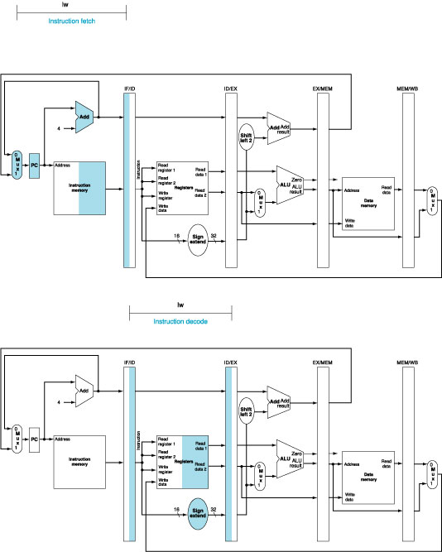
3. Pipeline Datapath: IF Stage
At the end of a cycle, IF/ID receives (stores):
Instruction read from InstructionMemory[ PC ]
PC + 4
PC + 4
Also connected to one of the MUX's inputs (another coming later)

Slide 19
3. Pipeline Datapath: ID Stage
At the beginning of a cycle IF/ID register supplies: | At the end of a cycle ID/EX receives:
Register numbers for reading two registers 16-bit offset to be sign-extended to 32-bit | Data values read from register file 32-bit immediate value PC + 4

Slide 20
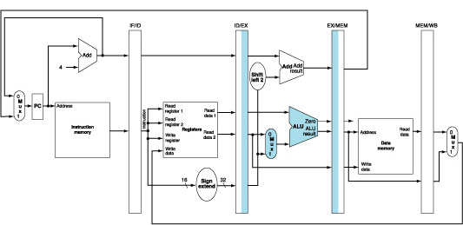
3. Pipeline Datapath: EX Stage
At the beginning of a cycle ID/EX register supplies: | At the end of a cycle EX/MEM receives:
Data values read from register file 32-bit immediate value PC + 4 | (PC + 4) + (Immediate x 4) ALU result isZero? signal Data Read 2 from register file

Slide 21
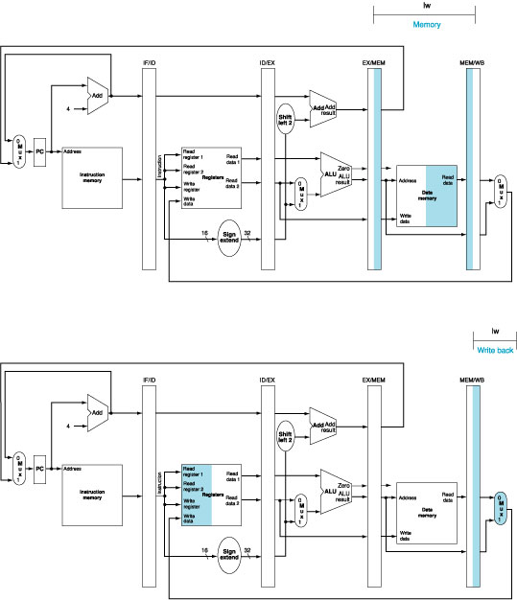
3. Pipeline Datapath: MEM Stage
At the beginning of a cycle EX/MEM register supplies: | At the end of a cycle MEM/WB receives:
(PC + 4) + (Immediate x 4) ALU result isZero? signal Data Read 2 from register file | ALU result Memory read data

Slide 22
3. Pipeline Datapath: WB Stage
At the beginning of a cycle MEM/WB register supplies: | At the end of a cycle
ALU result Memory read data | Result is written back to register file (if applicable) There is a bug here…….

Slide 23
3. Corrected Datapath (1/2)
Observe the “Write register” number
Supplied by the IF/ID pipeline register
It is NOT the correct write register for the instruction now in WB stage!
Solution:
Pass “Write register” number from ID/EX through EX/MEM to MEM/WB pipeline register for use in WB stage
i.e. let the "Write register" number follows the instruction through the pipeline until it is needed in WB stage

Slide 24
3. Corrected Datapath (2/2)

Slide 25
4. Pipeline Control: Main Idea
Same control signals as single-cycle datapath
Difference: Each control signal belongs to a particular pipeline stage

Slide 26
4. Pipeline Control: Try it!
Try associating each control signal with the correct pipeline stage.

Slide 27
4. Pipeline Control: Grouping
Group control signals according to pipeline stage
 | RegDst | ALUSrc | MemToReg | Reg Write | Mem Read | Mem Write | Branch | ALUop
 |  |  |  |  |  |  |  | op1 | op0
R-type | 1 | 0 | 0 | 1 | 0 | 0 | 0 | 1 | 0
lw | 0 | 1 | 1 | 1 | 1 | 0 | 0 | 0 | 0
sw | X | 1 | X | 0 | 0 | 1 | 0 | 0 | 0
beq | X | 0 | X | 0 | 0 | 0 | 1 | 0 | 1
 | EX Stage |  |  |  | MEM Stage |  |  | WB Stage
 | RegDst | ALUSrc | ALUop |  | Mem Read | Mem Write | Branch | MemToReg | Reg Write
 |  |  | op1 | op0
R-type | 1 | 0 | 1 | 0 | 0 | 0 | 0 | 0 | 1
lw | 0 | 1 | 0 | 0 | 1 | 0 | 0 | 1 | 1
sw | X | 1 | 0 | 0 | 0 | 1 | 0 | X | 0
beq | X | 0 | 0 | 1 | 0 | 0 | 1 | X | 0

Slide 28
4. Pipeline Control: Implementation
Signal used in EX stage and onwards
Signal generated in ID stage
Signal propagated along until utilized

Slide 29
4. Pipeline Control: Datapath and Control

Slide 30
5. Different Implementations
Single-Cycle
Cycle 1
Cycle 2
Clk
Load
Store
Waste
Multi-Cycle
Cycle 1
Cycle 2
Cycle 3
Cycle 4
Cycle 5
Cycle 6
Cycle 7
Cycle 8
Cycle 9
Cycle 10
Clk
Load
Store
R-type
IF
ID
EX
MEM
WB
IF
ID
EX
MEM
IF
Pipeline
Load
IF
ID
EX
MEM
WB
Store
IF
ID
EX
MEM
WB
R-type
IF
ID
EX
MEM
WB

Slide 31
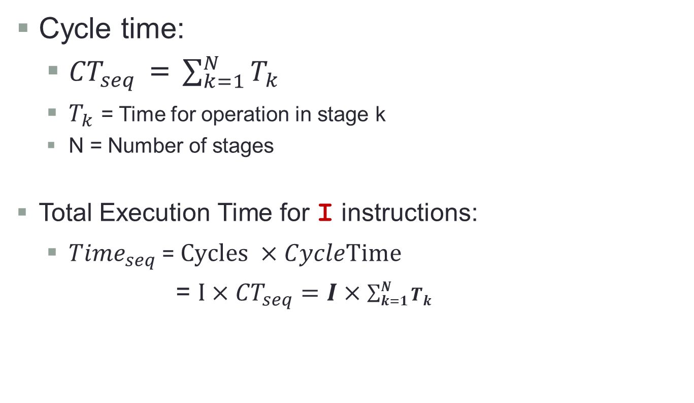
5. Single Cycle Processor: Performance
Cycle time:
${CT}_{seq}$ = $\sum_{k=1}^{N}{T_{k}}$
$T_{k}$ = Time for operation in stage k
N = Number of stages
Total Execution Time for I instructions:
${Time}_{seq}$ = $Cycles ×CycleTime$
= $I×{CT}_{seq}=I×\sum_{k=1}^{N}{T_{k}}$

Slide 32
5. Single Cycle Processor: Example
Instruction | Inst Mem | Reg read | ALU | Data Mem | Reg write | Total
ALU | 2 | 1 | 2 |  | 1 | 6
lw | 2 | 1 | 2 | 2 | 1 | 8
sw | 2 | 1 | 2 | 2 |  | 7
beq | 2 | 1 | 2 |  |  | 5
Cycle Time
Choose the longest total time = 8ns
To execute 100 instructions:
100 × 8ns = 800ns

Slide 33
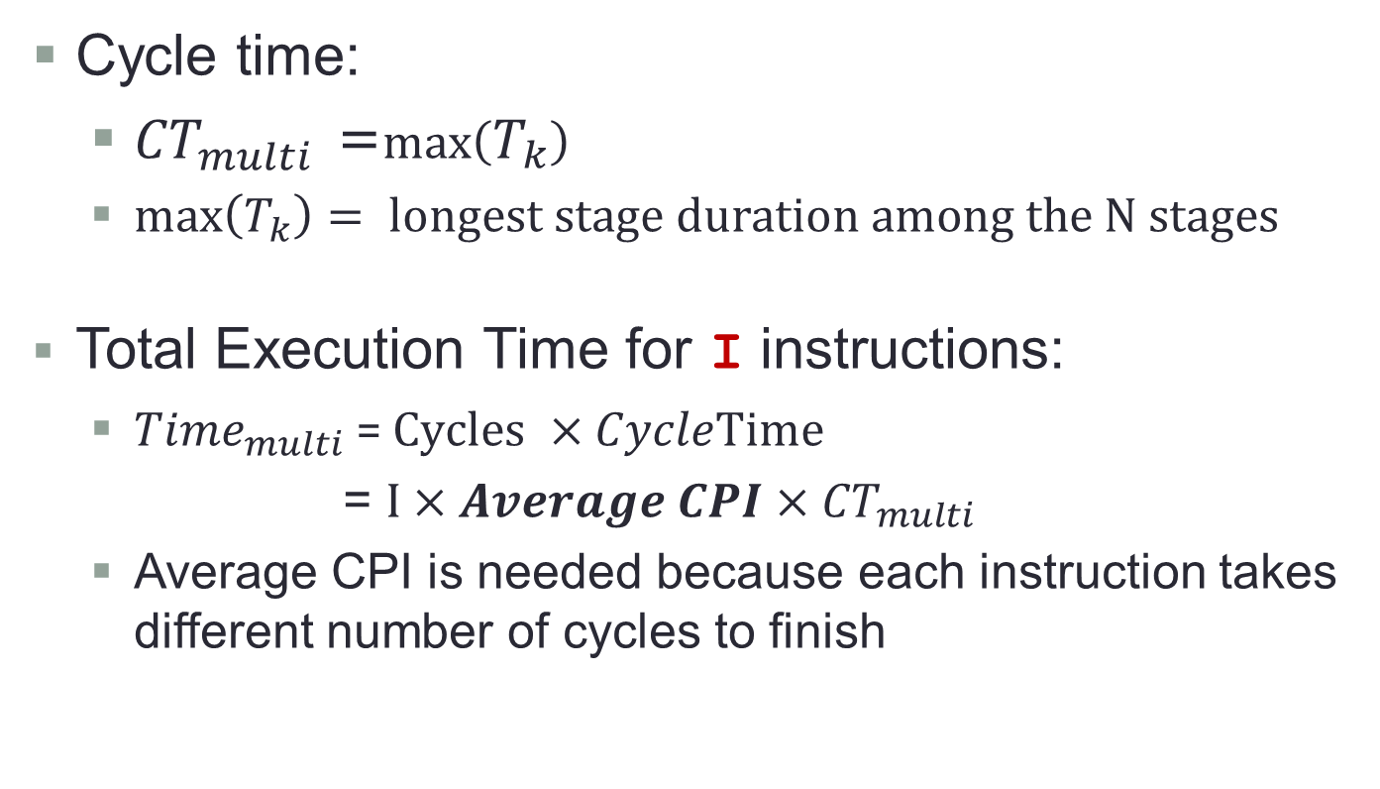
5. Multi-Cycle Processor: Performance
Cycle time:
${CT}_{multi}$ =$\max\left(T_{k}\right)$
$\max\left(T_{k}\right)= \text{longest} \text{stage} \text{duration} \text{among} \text{the} \text{N} \text{stages}$
Total Execution Time for I instructions:
${Time}_{multi}$ = $Cycles ×CycleTime$
= $I×Average CPI×{CT}_{multi}$
Average CPI is needed because each instruction takes different number of cycles to finish

Slide 34
5. Multi-Cycle Processor: Example
Instruction | Inst Mem | Reg read | ALU | Data Mem | Reg write | Total
ALU | 2 | 1 | 2 |  | 1 | 6
lw | 2 | 1 | 2 | 2 | 1 | 8
sw | 2 | 1 | 2 | 2 |  | 7
beq | 2 | 1 | 2 |  |  | 5
Cycle Time
Choose the longest stage time = 2ns
To execute 100 instructions, with a given average CPI of 4.6
100 × 4.6 × 2ns = 920ns

Slide 35
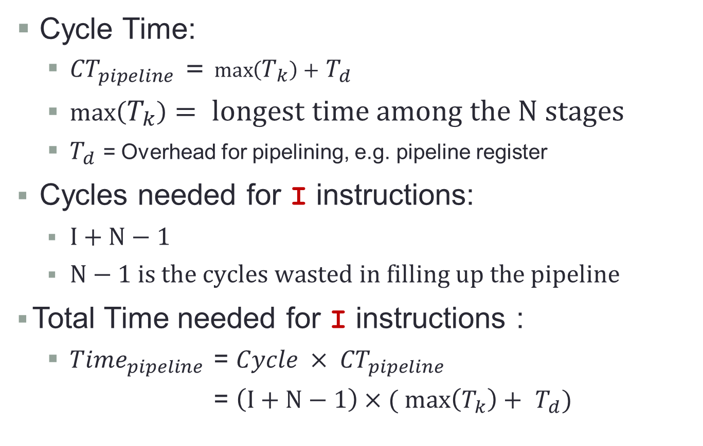
5. Pipeline Processor: Performance
Cycle Time:
${CT}_{pipeline}$ = $\max\left(T_{k}\right)+$ $T_{d}$
$\max\left(T_{k}\right)= \text{longest} \text{time} \text{among} \text{the} \text{N} \text{stages}$
$T_{d}$ = Overhead for pipelining, e.g. pipeline register
Cycles needed for I instructions:
$I+N−1$
$N−1 is the cycles wasted in filling up the pipeline$
Total Time needed for I instructions :
${Time}_{pipeline}$ = ${Cycle × CT}_{pipeline}$
= $\left(I+N−1\right)×( max\left(T_{k}\right)+ T_{d})$

Slide 36
5. Pipeline Processor: Example
Instruction | Inst Mem | Reg read | ALU | Data Mem | Reg write | Total
ALU | 2 | 1 | 2 |  | 1 | 6
lw | 2 | 1 | 2 | 2 | 1 | 8
sw | 2 | 1 | 2 | 2 |  | 7
beq | 2 | 1 | 2 |  |  | 5
Cycle Time
assume pipeline register delay of 0.5ns
longest stage time + overhead = 2 + 0.5 = 2.5ns
To execute 100 instructions:
(100 + 5 – 1) × 2.5ns = 260ns

Slide 37
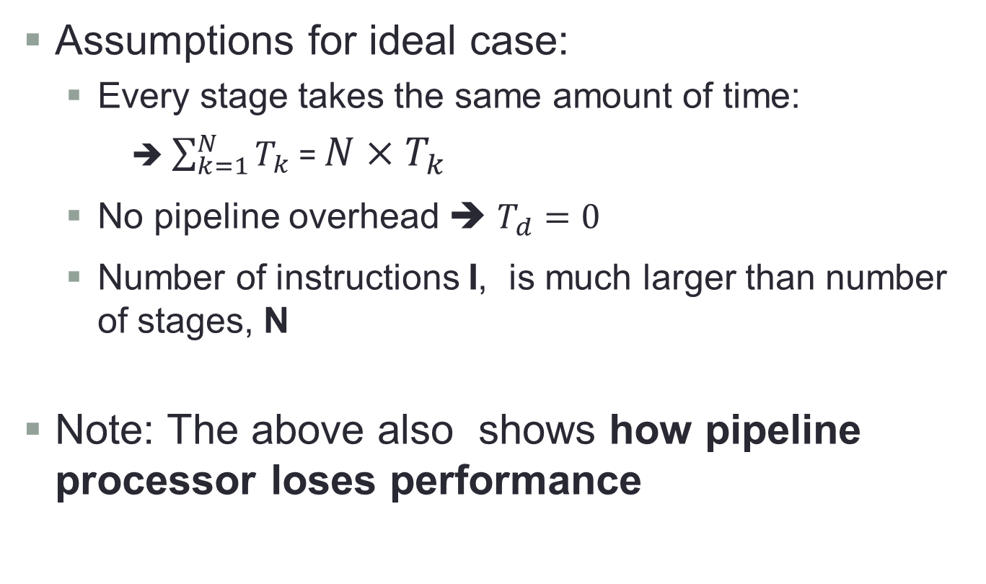
5. Pipeline Processor: Ideal Speedup (1/2)
Assumptions for ideal case:
Every stage takes the same amount of time:
➔ $\sum_{k=1}^{N}{T_{k}}$ = ${N×T}_{k}$
No pipeline overhead ➔ $T_{d}=0$
Number of instructions I, is much larger than number of stages, N
Note: The above also shows how pipeline processor loses performance

Slide 38
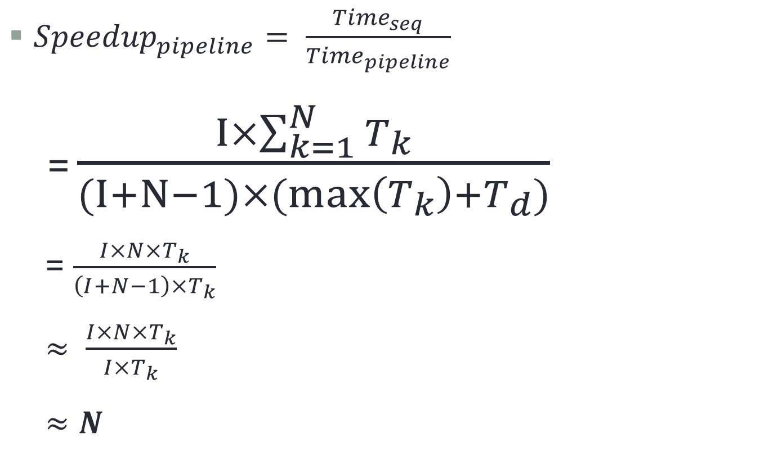
5. Pipeline Processor: Ideal Speedup (2/2)
${Speedup}_{pipeline}= \frac{{Time}_{seq}}{{Time}_{pipeline}}$
= $\frac{I×\sum_{k=1}^{N}{T_{k}}}{(I+N−1)×(max\left(T_{k}\right)+T_{d})}$
= $\frac{I×N×T_{k}}{\left(I+N−1\right)×T_{k}}$
$≈ \frac{I×N×T_{k}}{I×T_{k}}$
$≈N$
Conclusion:
Pipeline processor can gain N times speedup, where N is the number of pipeline stages

Slide 39
Review Question
4 cycles
Given this code:
add $t0, $s0, $s1
sub $t1, $s0, $s1
sll $t2, $s0, 2
srl $t3, $s1, 2
4/(100×10⁶) = 40 ns
4 + 4 = 8 cycles
8/(500×10⁶) = 16 ns
How many cycles will it take to execute the code on a single-cycle datapath?
How long will it take to execute the code on a single-cycle datapath, assuming a 100 MHz clock?
How many cycles will it take to execute the code on a 5-stage MIPS pipeline?
How long will it take to execute the code on a 5-stage MIPS pipeline, assuming a 500 MHz clock?


